Slide 1




THE INFRASTRUCTURE
01
RIFT
The Infrastructure For The Next Generation Of Market Participation.
Trade. Participate. Grow.
Self-Custodial · Intelligent · Global
Powered by Hyperliquid
RIFT — The Infrastructure For The Next Generation Of Market Participation.

Slide 2

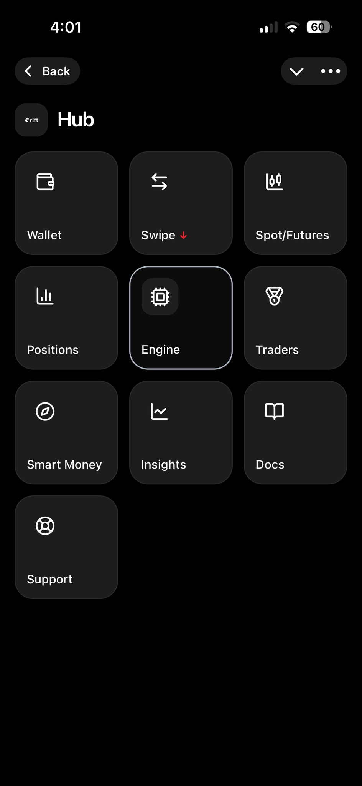
INTRODUCING RIFT
02
One Infrastructure.
Multiple Ways To Participate.
RIFT brings different forms of market participation together through one unified infrastructure.
From learning and manual trading to automated execution, portfolio-based participation, rewards, and future capital access.
One Platform.
Multiple Participation Environments.
RIFT — The Infrastructure For The Next Generation Of Market Participation.

Slide 3

MEET OUR VISIONARY CEO
03
SHAVEZ AHMED SIDDIQUI
Founder · Fintech Visionary · Blockchain Innovator
At the heart of RIFT is a vision for financial infrastructure that makes modern market participation more accessible, structured, and technology-driven.
VISION
Build a long-term, scalable ecosystem where technology enables broader participation and creates infrastructure through which the community can grow together.
THE MISSION
Build the infrastructure.
Expand access.
Create better ways to participate.
RIFT — The Infrastructure For The Next Generation Of Market Participation.

Slide 4
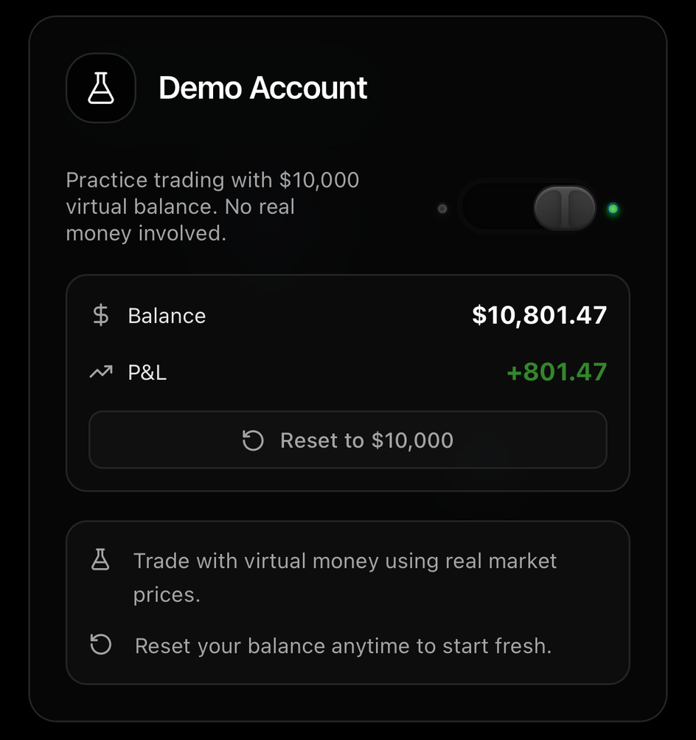
FREE DEMO ACCOUNT
04
Start With Practice. Trade With Understanding.
Every new RIFT user can begin with a $10,000 virtual demo account.
No real capital required.
WHAT YOU CAN DO
• Explore the RIFT interface
• Practice market participation
• Test trading ideas
• Experience execution
• Learn before going live
• Reset your virtual balance when needed
$10,000
Practice first. Participate with confidence.
Virtual Trading Capital
RIFT — The Infrastructure For The Next Generation Of Market Participation.

Slide 5

RIFT SWIPE
05
Simpler Decisions. Faster Execution.
RIFT Swipe transforms trade selection into a simple, intuitive interaction.
HOW IT WORKS
LEFT
RIGHT
SKIP
EXECUTE
One opportunity at a time.
Instead of navigating a complex trading terminal for every decision, Swipe creates a focused environment designed around quick market interaction.
RIFT — The Infrastructure For The Next Generation Of Market Participation.

Slide 6
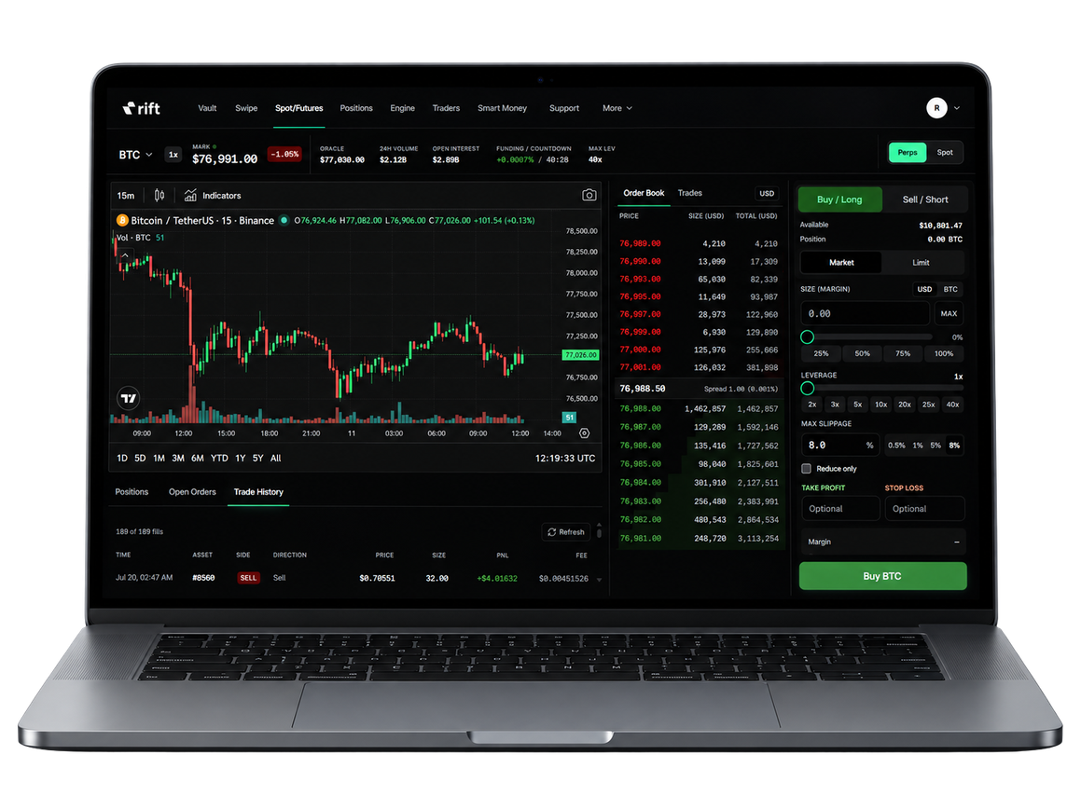
SPOT/FUTURES
06
Trade with precision through manual trading terminal.
Choose Spot or Perps, switch between Market & Limit orders, and manage leverage, slippage, Take Profit & Stop Loss — all from one interface.
PRECISE. FLEXIBLE. EXECUTE.
RIFT — The Infrastructure For The Next Generation Of Market Participation.

Slide 7

RIFT SMART MONEY
07
Think Portfolio.
Not Just Trades.
RIFT Smart Money introduces a broader approach to market participation.
Instead of focusing only on individual entries and exits, Smart Money is built around Trading Books.
TRADING BOOKS
MIRROR WALLETS
A structured environment where capital participation can be viewed at the portfolio level.
Dedicated infrastructure supporting each Trading Book and maintaining separation between participation environments.
RIFT — The Infrastructure For The Next Generation Of Market Participation.

Slide 8
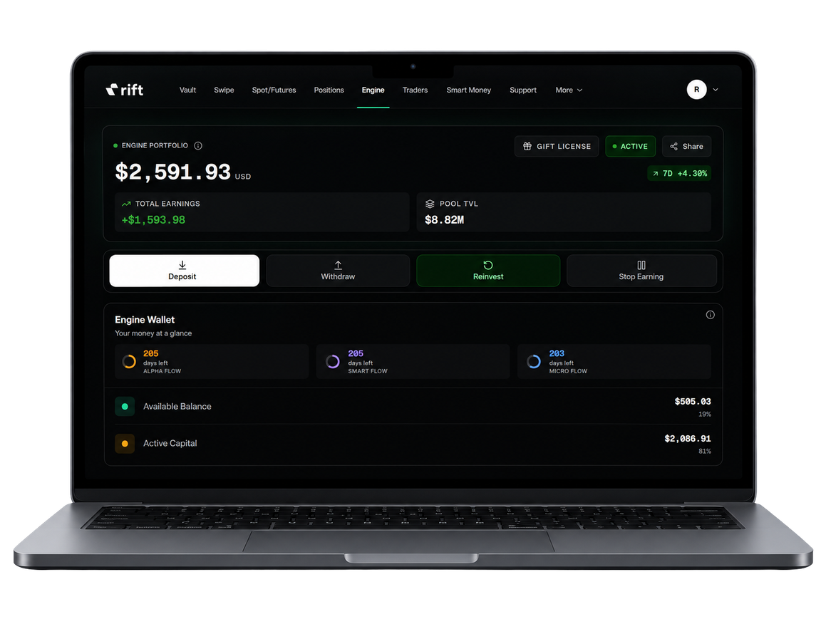
RIFT AUTOMATED TRADING ENGINE
08
Structured Participation.
Automated Execution.
RIFT Auto Engine is designed for participants who want market participation through predefined automated cycles rather than constant manual execution.
The Engine combines structured execution environments with automated participation infrastructure.
BUILT AROUND
Automated Execution
Structured Cycles
Continuous Participation
Capital Efficiency
Less manual intervention.
More structured participation.
RIFT — The Infrastructure For The Next Generation Of Market Participation.

Slide 9

AUTO ENGINE FLOWS
09
THREE FLOWS. ONE AUTOMATED ENGINE.
RIFT Auto Engine provides three distinct participation environments.
01 — MICRO FLOW
02 — SMART FLOW
03 — ALPHA FLOW
Entry: $100
Entry: $500
Entry: $1,000
Designed for participants starting with a lower capital allocation.
Designed for participants seeking a larger structured allocation.
Designed for participants seeking the highest allocation environment within the Engine.
ENGINE STRUCTURE
365-Day Environment
24-Hour Participation Cycles
Capital Lock From $11 — No Stated Upper Limit
*Targets may vary and are not guaranteed. Participation involves market risk.
RIFT — The Infrastructure For The Next Generation Of Market Participation.

Slide 10

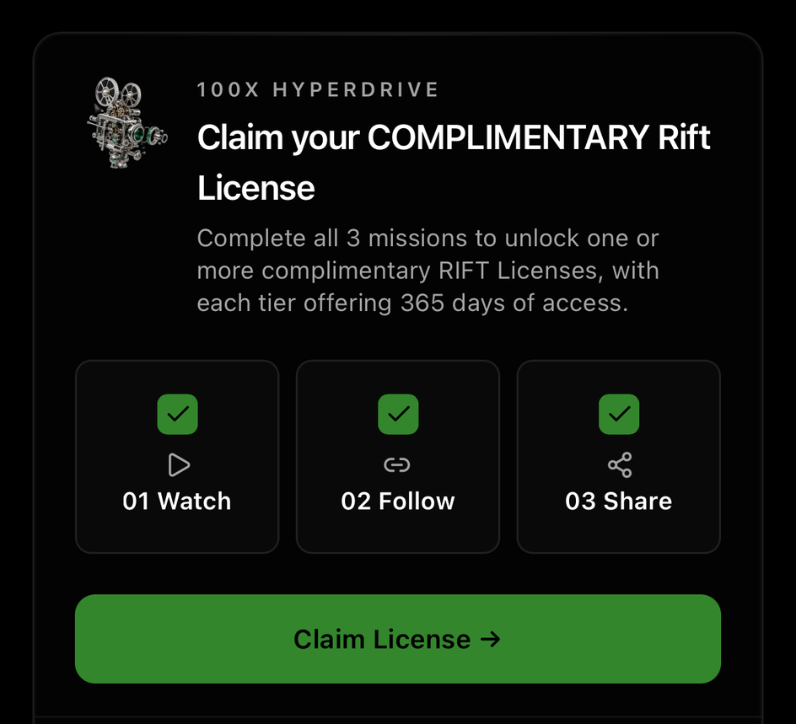
100X HYPERDRIVE CAMPAIGN
10
RIFT 100X HYPERDRIVE
Limited Time Opportunity
Your Gateway To The Auto Engine.
100X HYPERDRIVE is a limited-time onboarding opportunity designed to introduce users to the RIFT ecosystem before activating the Auto Engine.
RIFT — The Infrastructure For The Next Generation Of Market Participation.

Slide 11
CLAIM COMPLIMENTARY LICENSE
11
COMPLETE THREE MISSIONS
UPGRADE OPPORTUNITY
01 — WATCH & LEARN 🎬
Complete the required RIFT content and learn how the ecosystem works.
During the 100X HYPERDRIVE campaign, users with an existing Micro Flow or Smart Flow can upgrade to Alpha Flow.
Limited-time campaign. Eligibility and applicable terms apply.
02 — FOLLOW & CONNECT 🔗
Follow official RIFT channels and stay connected with product updates, announcements, and the community.
03 — GO VIRAL 🚀
Receive your personalized RIFT Welcome Card and share it with your network.
COMPLIMENTARY LICENSE UNLOCKED
Claim Your Complimentary RIFT Auto Engine License(s).
Choose:
Micro Flow · Smart Flow · Alpha Flow or select all three.
RIFT — The Infrastructure For The Next Generation Of Market Participation.

Slide 12
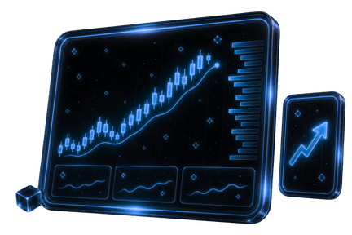
PROP TRADING — COMING SOON
12
From Proven Performance to Capital Access.
Prop Trading is being built as a structured infrastructure for evaluating traders, managing risk, and allocating trading capital based on measurable performance.
EVALUATE
QUALIFY
ALLOCATE
  Structured challenges
  Trading performance
  Risk discipline
  Drawdown controls
  Position limits
  Consistency metrics
  Capital access
  Defined risk parameters
  Trading infrastructure
SCALE
  Performance-based progression
  Larger capital opportunities
  Advanced trading environments
COMING SOON!
RIFT — The Infrastructure For The Next Generation Of Market Participation.

Slide 13

RIFT REFERRAL SYSTEM
13
Earn From The Activity You Bring Into The Network.
Share your unique RIFT referral link.
Anyone who signs up through it becomes part of your network, creating the basis for ongoing referral rewards from their eligible activity.
MANUAL TRADING FEES
AUTO TRADING SUCCESS FEES
YOUR REFERRAL DASHBOARD
L1 — 25%
L2 — 6.25%
L3 — 1.56%
L4 — 0.39%
L5 — 0.09%
L1 — 50%
L2 — 25%
L3 — 12.5%
L4 — 6.25%
L5 — 3.12%
Track:
• Network Growth
• Earnings Breakdown
• Daily Earnings
• Invite Trends
• Referral Activity
UP TO 5 LEVELS DEEP
Earn ongoing referral income from eligible downline trading activity.
RIFT — The Infrastructure For The Next Generation Of Market Participation.

Slide 14

RIFT X9 REWARDS
14
9 Reward Pools. Clear Qualification. Transparent Distribution.
A reward layer designed to recognize both personal RIFT Engine yield and balanced team performance.
HOW IT WORKS:
- Qualify through personal Engine yield + weaker-team yield
- Strongest direct team is removed from team calculation
- Users enter only their highest qualifying pool
- Rewards are checked on the 1st, 11th & 21st
- Qualified users share their pool balance equally
BUILD. QUALIFY. GET REWARDED.
RIFT — The Infrastructure For The Next Generation Of Market Participation.

Slide 15
TRANSPARENT FEES STRUCTURE
15
Clear Fees. No Hidden Complexity.
FEE
AMOUNT
PURPOSE
Account Activation
$10
One-time account activation and Vault access
Bridge Fee
0.5%
Deposits & withdrawals, plus applicable network gas costs
Trading Fee
0.1%
Execution across supported trading environments
Auto Engine Success Fee
20% of yield
Applied only to yield generated through Auto Engine
X9 Rewards Pool Allocation
9% of yield
Allocated across the nine X9 reward pools
You should always know what you're paying for.
Clear activation. Clear settlement. Clear trading. Clear performance-related fees.
Transparent by design.
THE PRINCIPLE
RIFT — The Infrastructure For The Next Generation Of Market Participation.

Slide 16

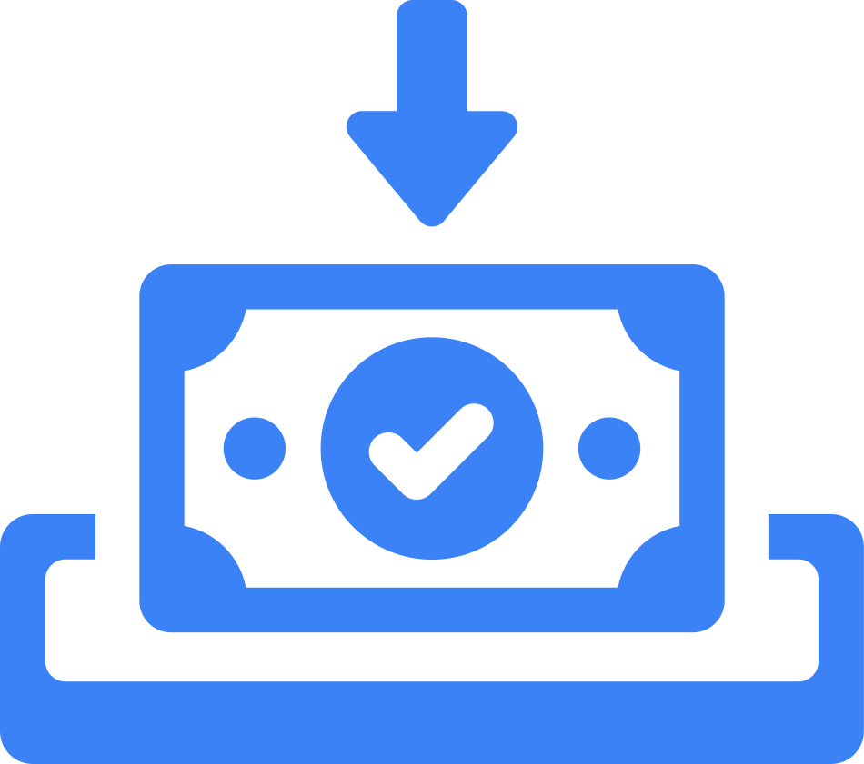


RIFT GROWTH JOURNEY
16
YOUR RIFT GROWTH JOURNEY
01 — START WITH FREE DEMO
02 — CLAIM YOUR COMPLIMENTARY LICENSE
Open your RIFT demo account with $10,000 in virtual funds.
Practice before going live.
Complete 100X HYPERDRIVE missions and claim your complimentary Auto Engine license(s).
Choose: Micro · Smart · Alpha or select all three flows
03 — DEPOSIT YOUR CAPITAL
04 — SHARE YOUR REFERRAL LINK
Fund your selected Engine environment.
Participate through structured 24-hour cycles and withdraw according to applicable cycle and platform terms.
Invite others using your unique RIFT referral link.
Earn eligible rewards from network activity.
05 — GROW YOUR NETWORK
Build your network. Earn Level Income.
Participate in the X9 Rewards system.
Learn. Participate. Grow.
RIFT — The Infrastructure For The Next Generation Of Market Participation.

Slide 17

THANK YOU
17
RIFT
Welcome To The Future Of Trading!
Learn. Trade. Grow.
RIFT
The Infrastructure For The Next Generation Of Market Participation.

